Slide 1
Sarcasm Target Detection
To introduce an automatic approach for Sarcasm Target Detection

Slide 2
An Example of Sarcasm :
My cell phone has an awesome battery that lasts 20 minutes
Target or Entity being ridiculed
Aspect or Attribute of the entity being ridiculed

Slide 3
Sarcasm Target Detection
Given a sarcastic text, sarcasm target identification is the task of extracting the subset of words that indicate the target of ridicule.
Sarcastic Text | Target
He is as good at coding as Tiger Woods is at avoiding controversy | He, Tiger Woods
Oh, and I suppose the apple ate the cheese | Outside
Don’t you just love it when Microsoft tells you that you’re spelling your own name wrong. | Microsoft

Slide 4
Importance in various other fields
Natural Language Processing : Being able to recognize the entity towards which the negative sentiment was intended, a natural language generation system will have more context to generate a response
Sentiment Analysis : It will be able to attribute the negative sentiment in a sarcastic text towards the correct aspect of a product or the appropriate entity.
Notes:
Negative sentiment will be associated with the correct aspect of entity .

Slide 5
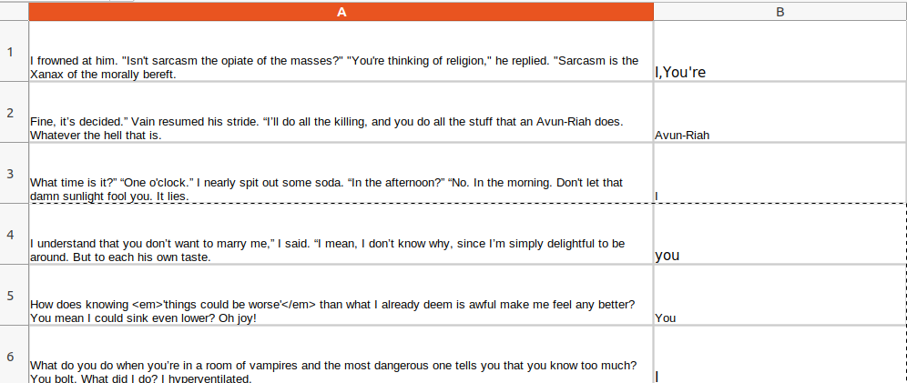
Dataset
A manually labeled dataset consisting of text from two mains: Tweets and Book snippets. (https://github.com/Pranav-Goel/Sarcasm-Target-Detection)
The output will be the subset of words indicating the target in the sarcastic text.
In case the text doesn’t have any target, output will be a fallback label ‘Outside’

Slide 6
Challenges in Sarcasm Target Detection
Presence of multiple candidate phrases
This phone heats up so much that I strongly recommend chefs around the world to use it as a cooktop.
Multiple sarcasm targets
He is as good at coding as Tiger Woods is at avoiding controversy.
Absence of a sarcasm target word (the ‘Outside’ case):
‘What a great way to start off the day!’

Slide 7
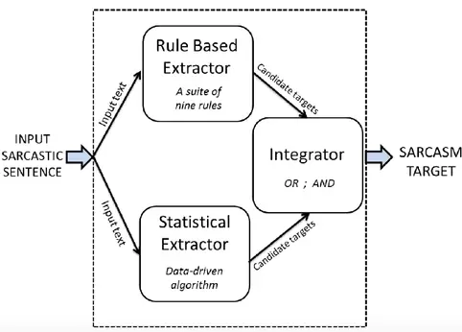
Rule Based Extractor : Implements nine rules to identify different kinds of sarcasm targets.
INPUT
OUTPUT
Sarcastic Sentence: Taken either from tweets or book snippets
Subset of words/Fall back label ‘Outside’
Integrator : Determines the sarcasm target based on the outputs of the two extractors. It has 2 configurations : Hybrid AND and hybrid OR.
Statistical Extractor : Uses statistical classification techniques.

Slide 8
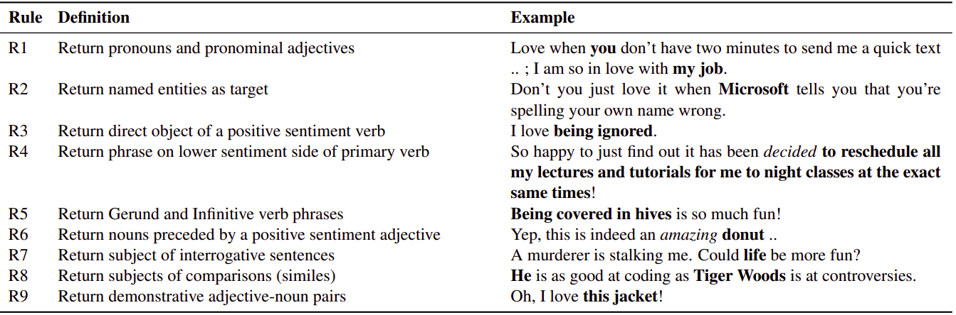
Rule Based Extractor

Slide 9
How to combine the outputs of individual Rules?
Weighted Majority Approach
Every rule applied to sarcastic text.
Each word of the sarcastic sentence is associated with a value/score which is sum of accuracy(which is determined by a rule based classifier) of each rule which predicted that word to be a part of sarcasm target.
Words corresponding to max score are returned.

Slide 10
Statistical Extractor
Use a classifier with, input: word (along with its features), and output: if the word is a sarcasm target.
For this, decompose the sentence(‘n’ words) into (‘n’ word) vector list.
Output for the sarcasm detection, then becomes one-hot-encoding of the target word(in case of single target), or combination of encodings(in case of multiple targets).
Instance is represented as a set of features:
Lexical
Part of Speech (POS)
Polarity
Pragmatic features
Finally, train this with words as instances while the sarcasm target as outputs.

Slide 11
Integrator
Determines sarcasm target based on output of 2 extractors.
There are two configurations.The idea of using two configurations OR and AND is based on a rule-based sarcasm detector by (Khattri et al., 2015).
The two configurations:
HYBRID OR : The final output is union of the set of words outputted by the two extractors. In case, both are empty sets, the final output will be fallback label Outside’. It is necessary so as to cover every candidate target as both extractors may not individually cover all targets.
HYBRID AND : The final output is intersection of the set of words outputted by the two extractors. In case, either of them is an empty set, the final output will be fallback label Outside’.It is quite intuitive as the intersection of both the sets seems to give sarcasm target.

Slide 12
Thank You

